Slide 1
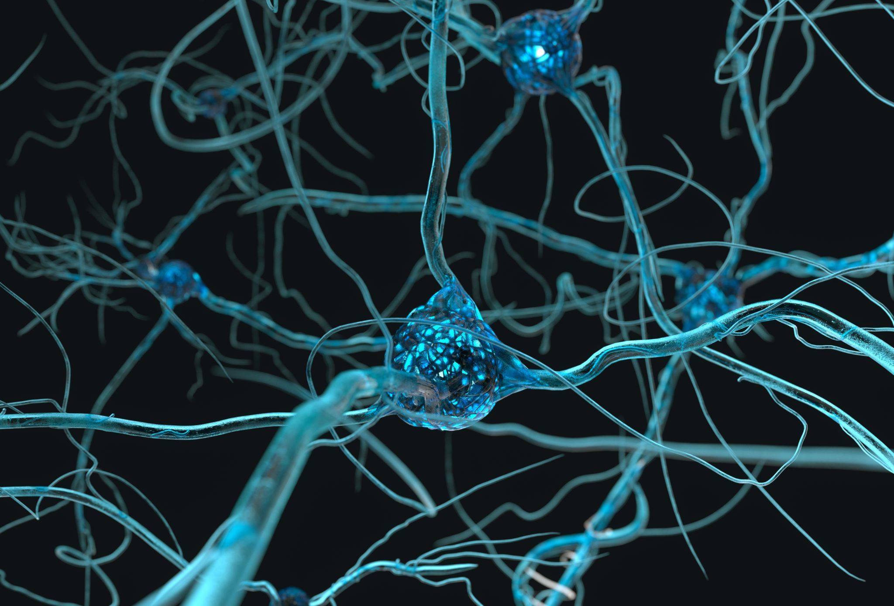
The Cell: Structure, Functions & Organelles
Dr. Bushra Zulfiqar

Slide 2
Introduction to Cell
• Basic structural and functional unit of life
• ~37 trillion cells in human body
• All cells arise from pre-existing cells

Slide 3
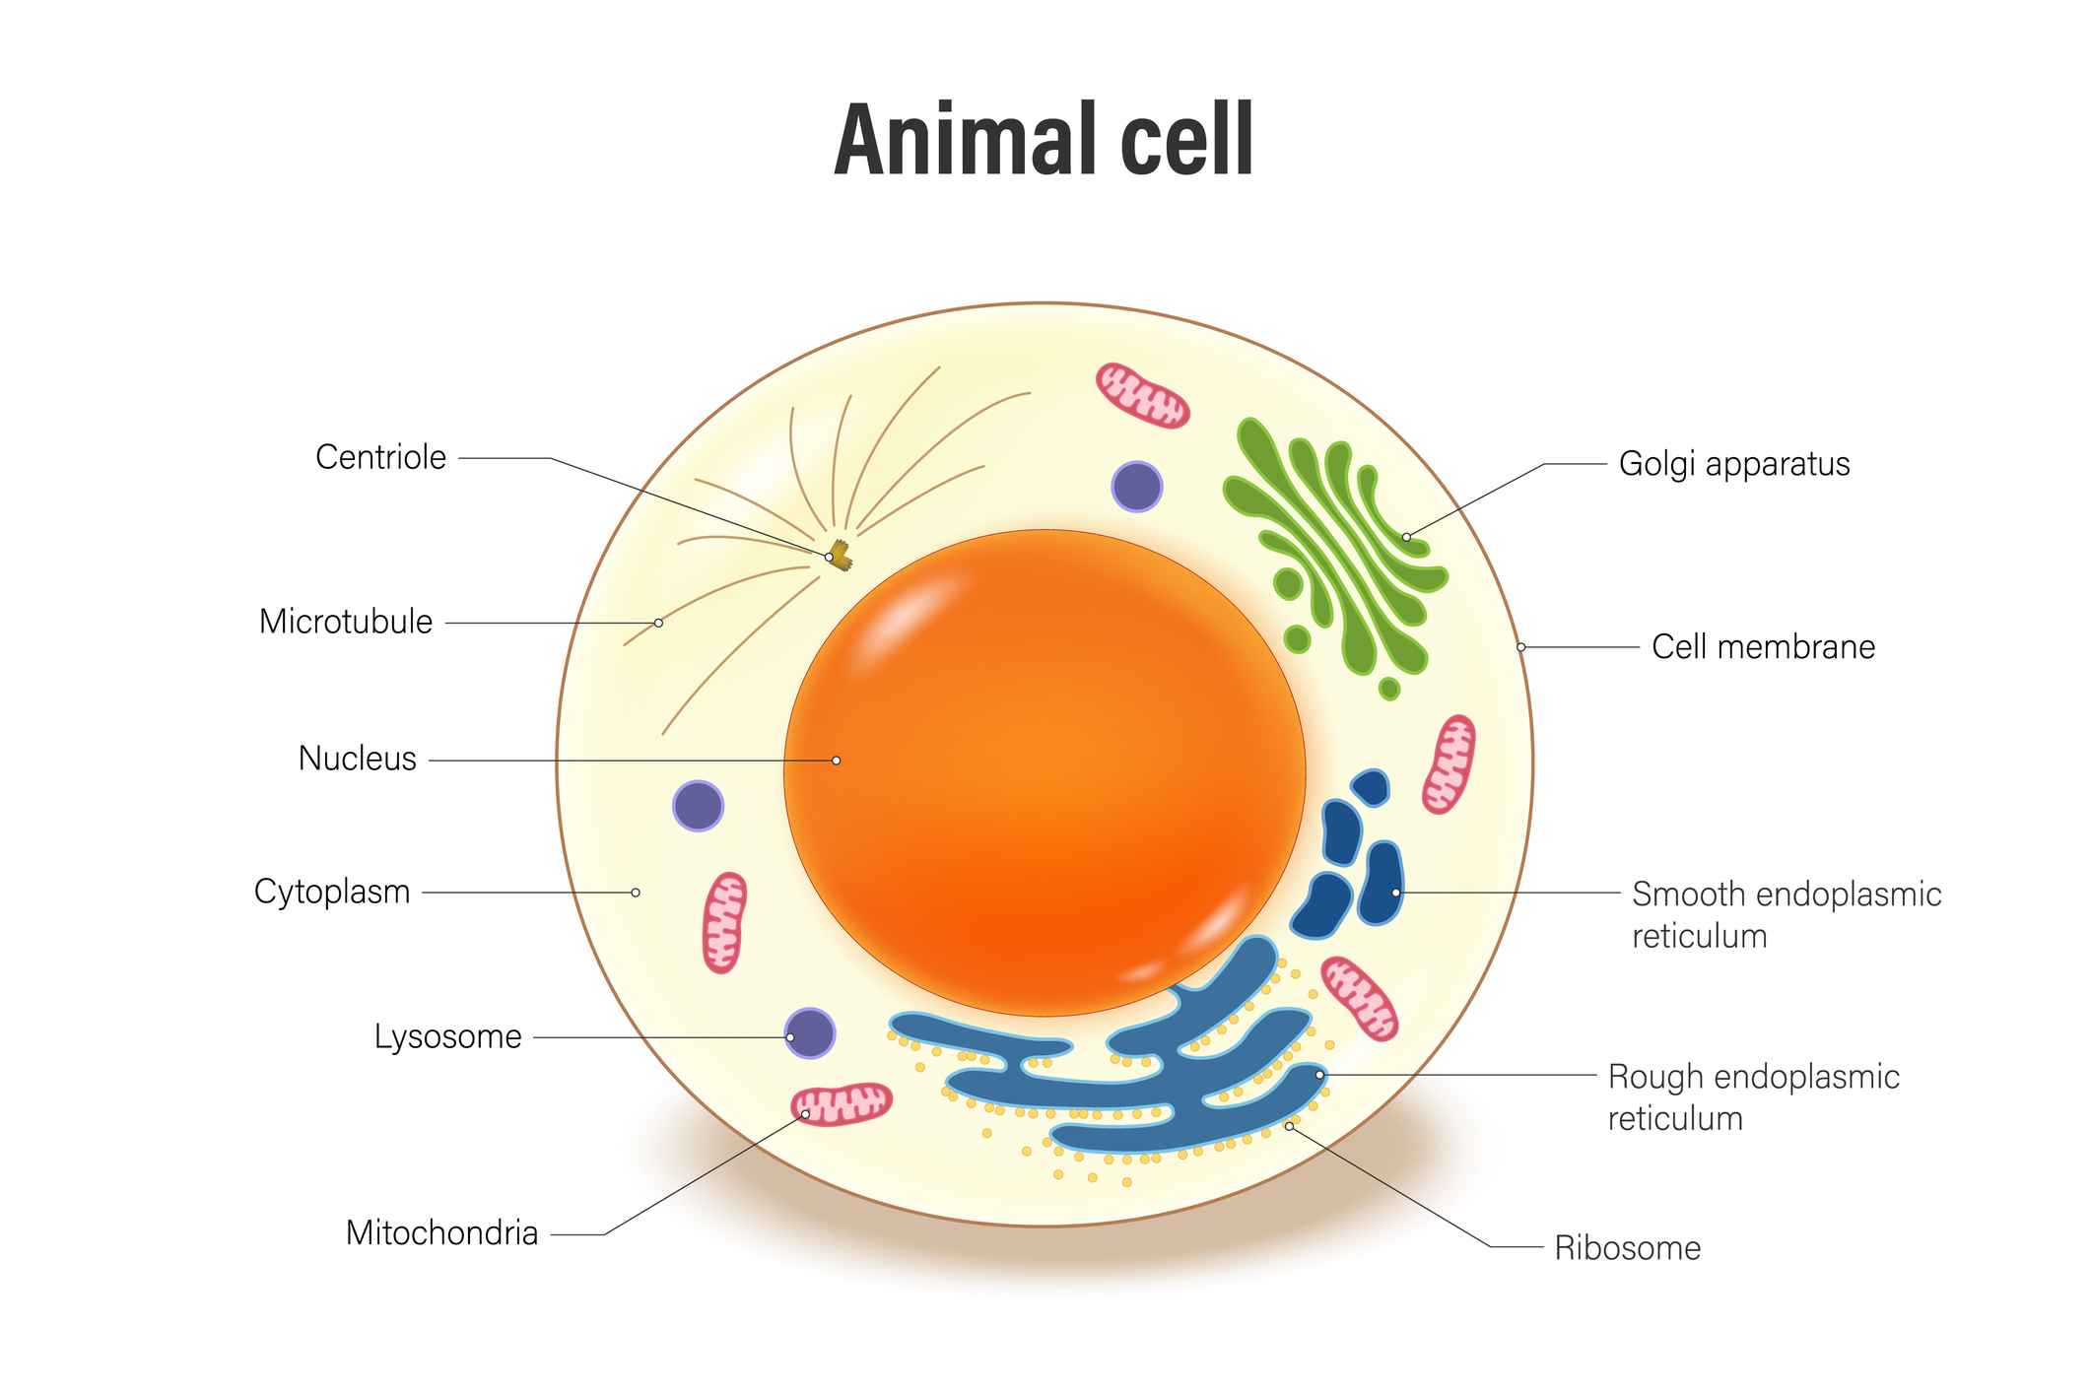

Slide 4
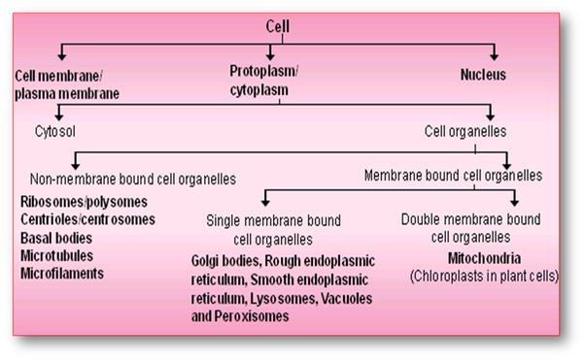

Slide 5
Cytoplasm
It acts as the store of important chemicals. It is a physical basis of all metabolic activities. It keeps the cell fully expanded and provides turgidity.
All the cell organelles resides in cytoplasm.
Organelle:
An organelle is a membrane bound structure that carries out specific activities for the cell

Slide 6
Functions of Cell
• Metabolism
• Growth
• Reproduction
• Irritability
• Conductivity
• Secretion & Excretion

Slide 7
Metabolism
Sum of all chemical reactions in the cell
Divided into:
Anabolism → synthesis of proteins, lipids, nucleic acids
Catabolism → breakdown of substances to release energy
📌 Example: Glucose → ATP via glycolysis & oxidative phosphorylation

Slide 8
Growth
Increase in cell size due to increased synthesis of:
Proteins
Cytoplasmic organelles
Requires adequate nutrition & oxygen
📌 Clinical note: Growth failure occurs in chronic malnutrition and hypoxia.

Slide 9
Reproduction
Formation of new cells
Mitosis → somatic cells
Meiosis → germ cells (sperms & ova)
📌 Controlled by:
Cell cycle regulators
DNA integrity checkpoint

Slide 10
Irritability (Responsiveness)
Ability of cell to respond to stimuli
Stimuli may be:
Chemical
Electrical
Mechanical
📌 Example: Neuron responds to electrical stimulus Muscle responds to acetylcholine

Slide 11
Conductivity
Transmission of impulses
Highly developed in:
Nerve cells
Muscle cells

Slide 12
Secretion
Synthesis and release of substances such as:
Hormones
Enzymes
Neurotransmitters
Requires RER → Golgi → vesicles

Slide 13
Excretion
Removal of waste products:
CO₂
Urea
Reactive oxygen species

Slide 14
Basic Cell Structure
• Cell membrane
• Cytoplasm
• Nucleus

Slide 15
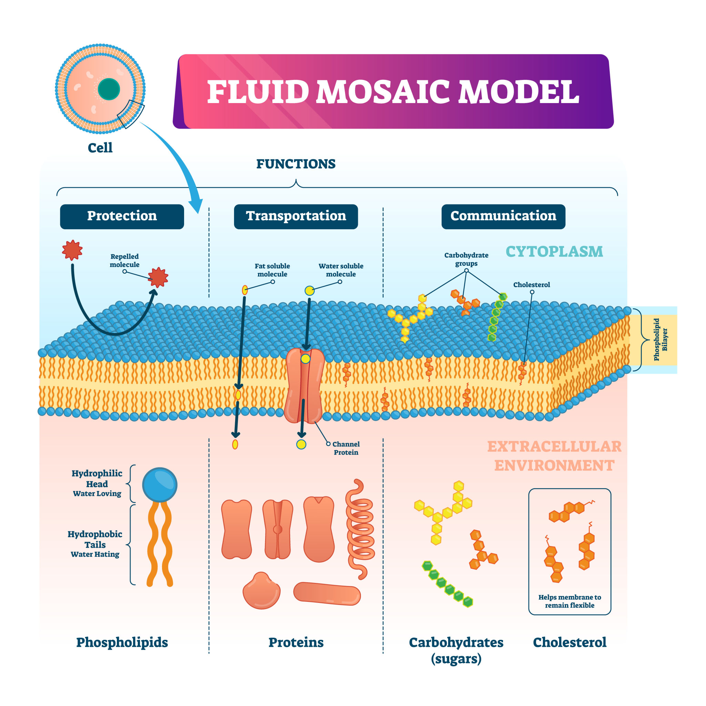
1.CELL MEMBRANE (PLASMA MEMBRANE):

Slide 16
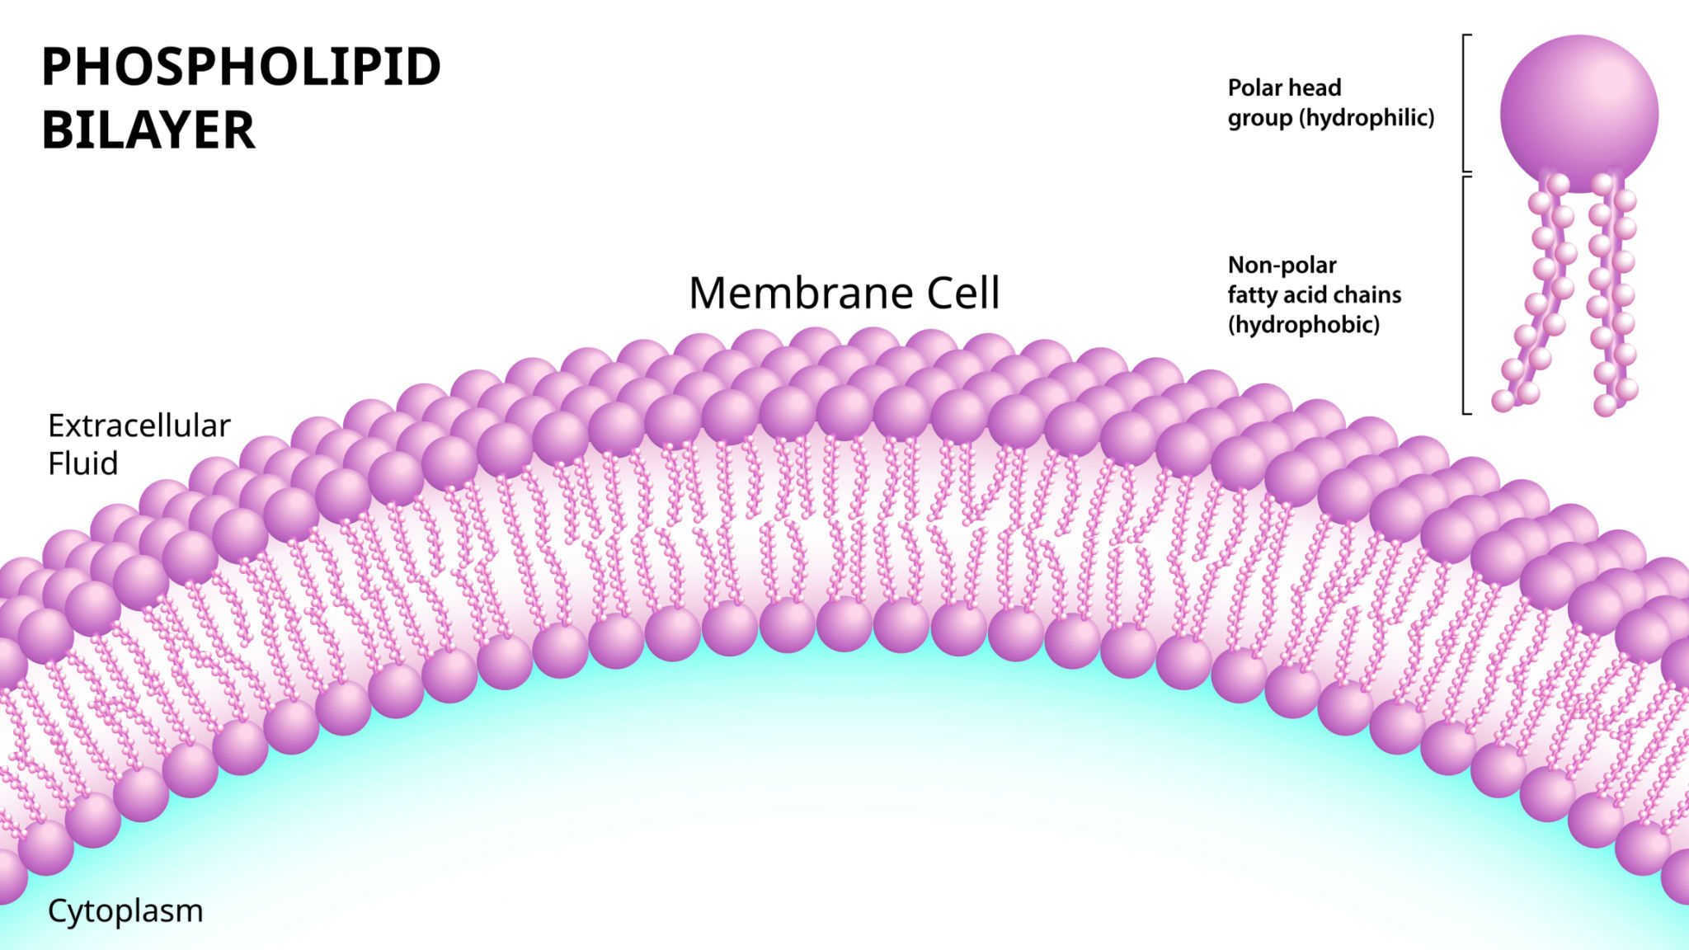

Slide 17
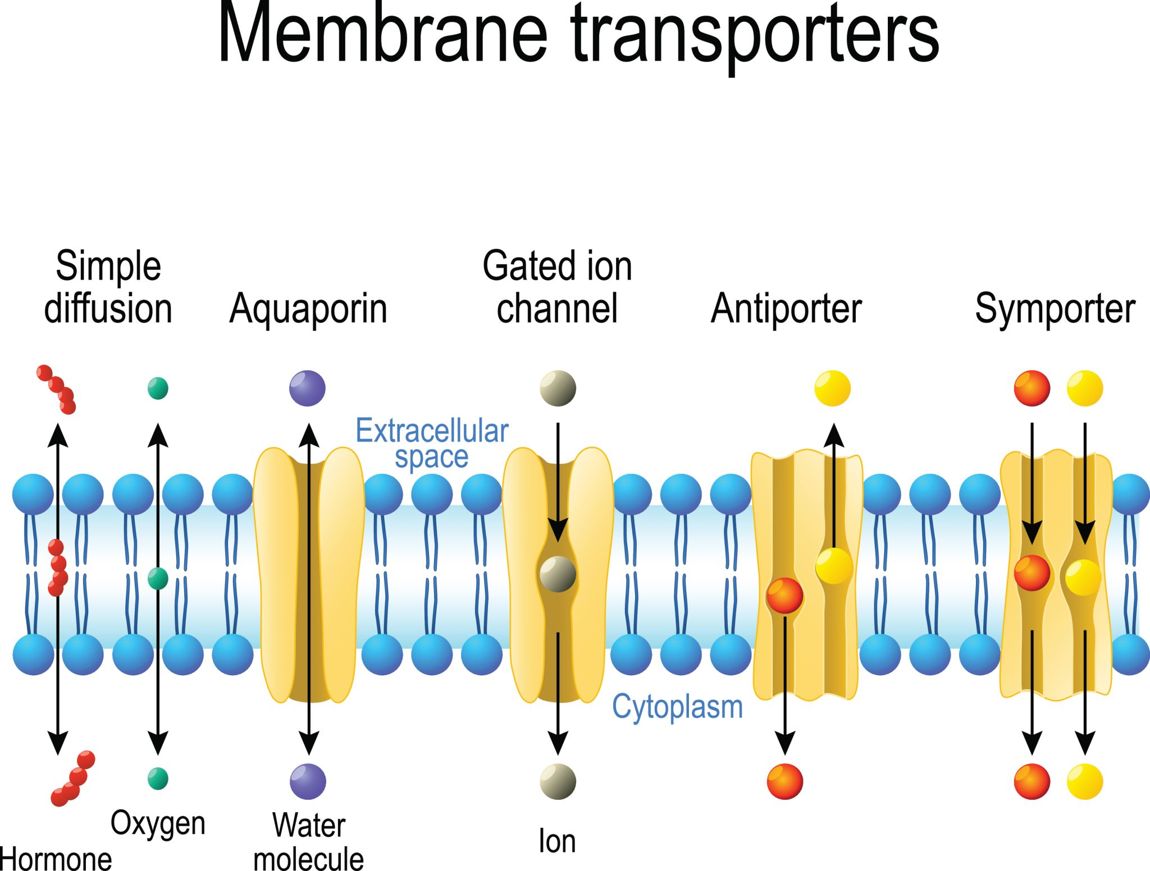

Slide 18
Structure
Thickness: 7–10 nm
Components:
Phospholipid bilayer
Proteins
Carbohydrates
Functions
Selective permeability
Cell recognition (antigens)
Signal reception (receptors)
Transport of ions & molecules

Slide 19
CYTOPLASM
Semi-fluid intracellular matrix
Contains:
Cytosol
Organelles
Cytoskeleton
Functions
Site of metabolic reactions
Intracellular transport
Maintains cell shape

Slide 20
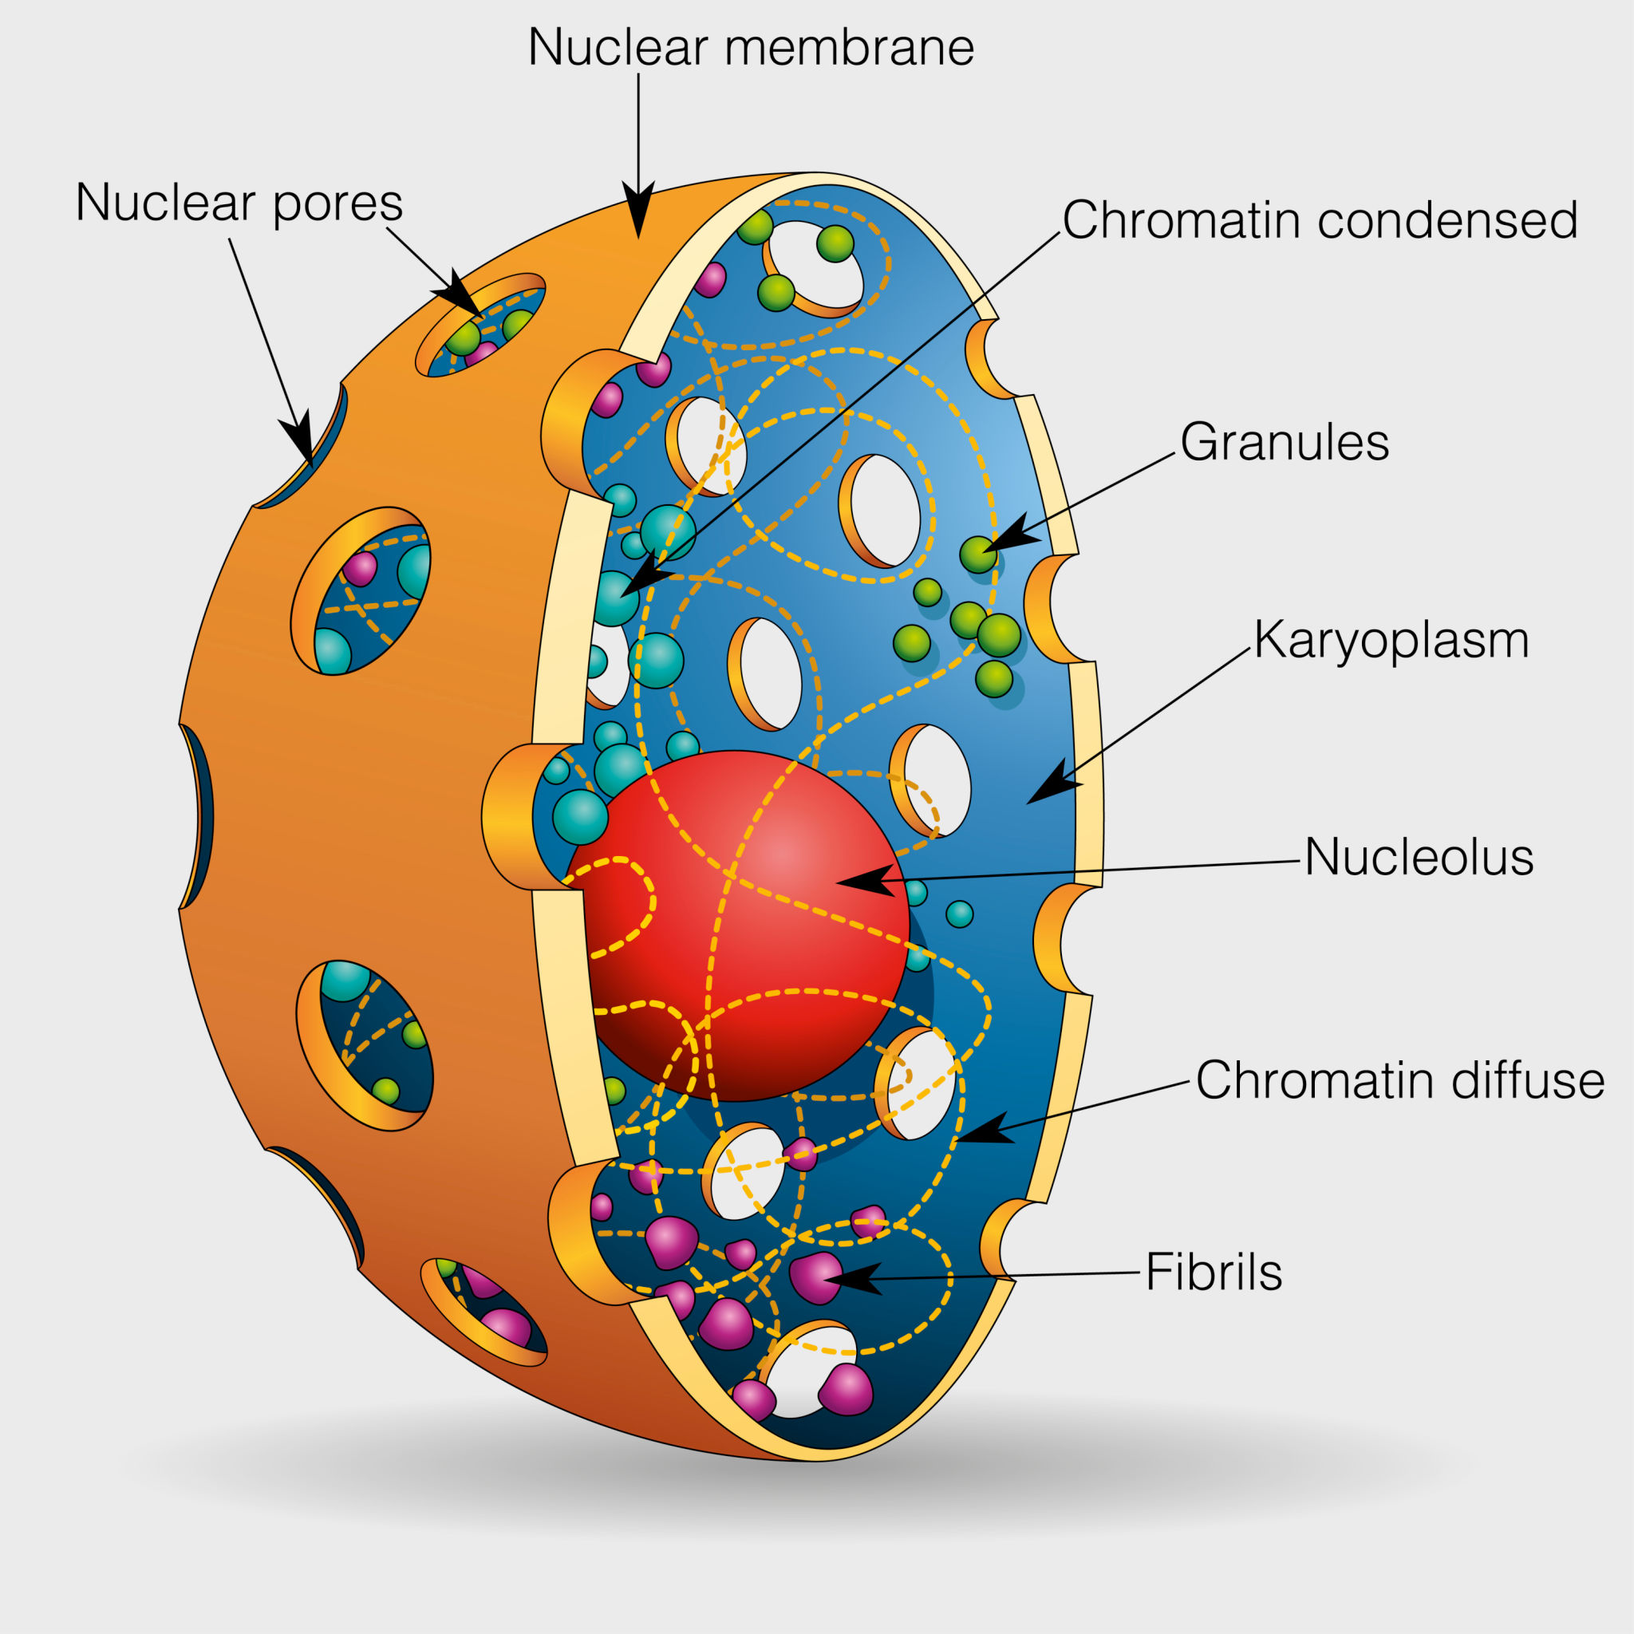
3. NUCLEUS

Slide 21
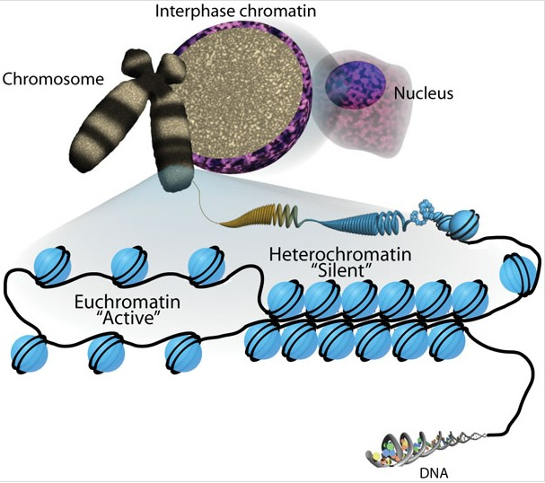

Slide 22
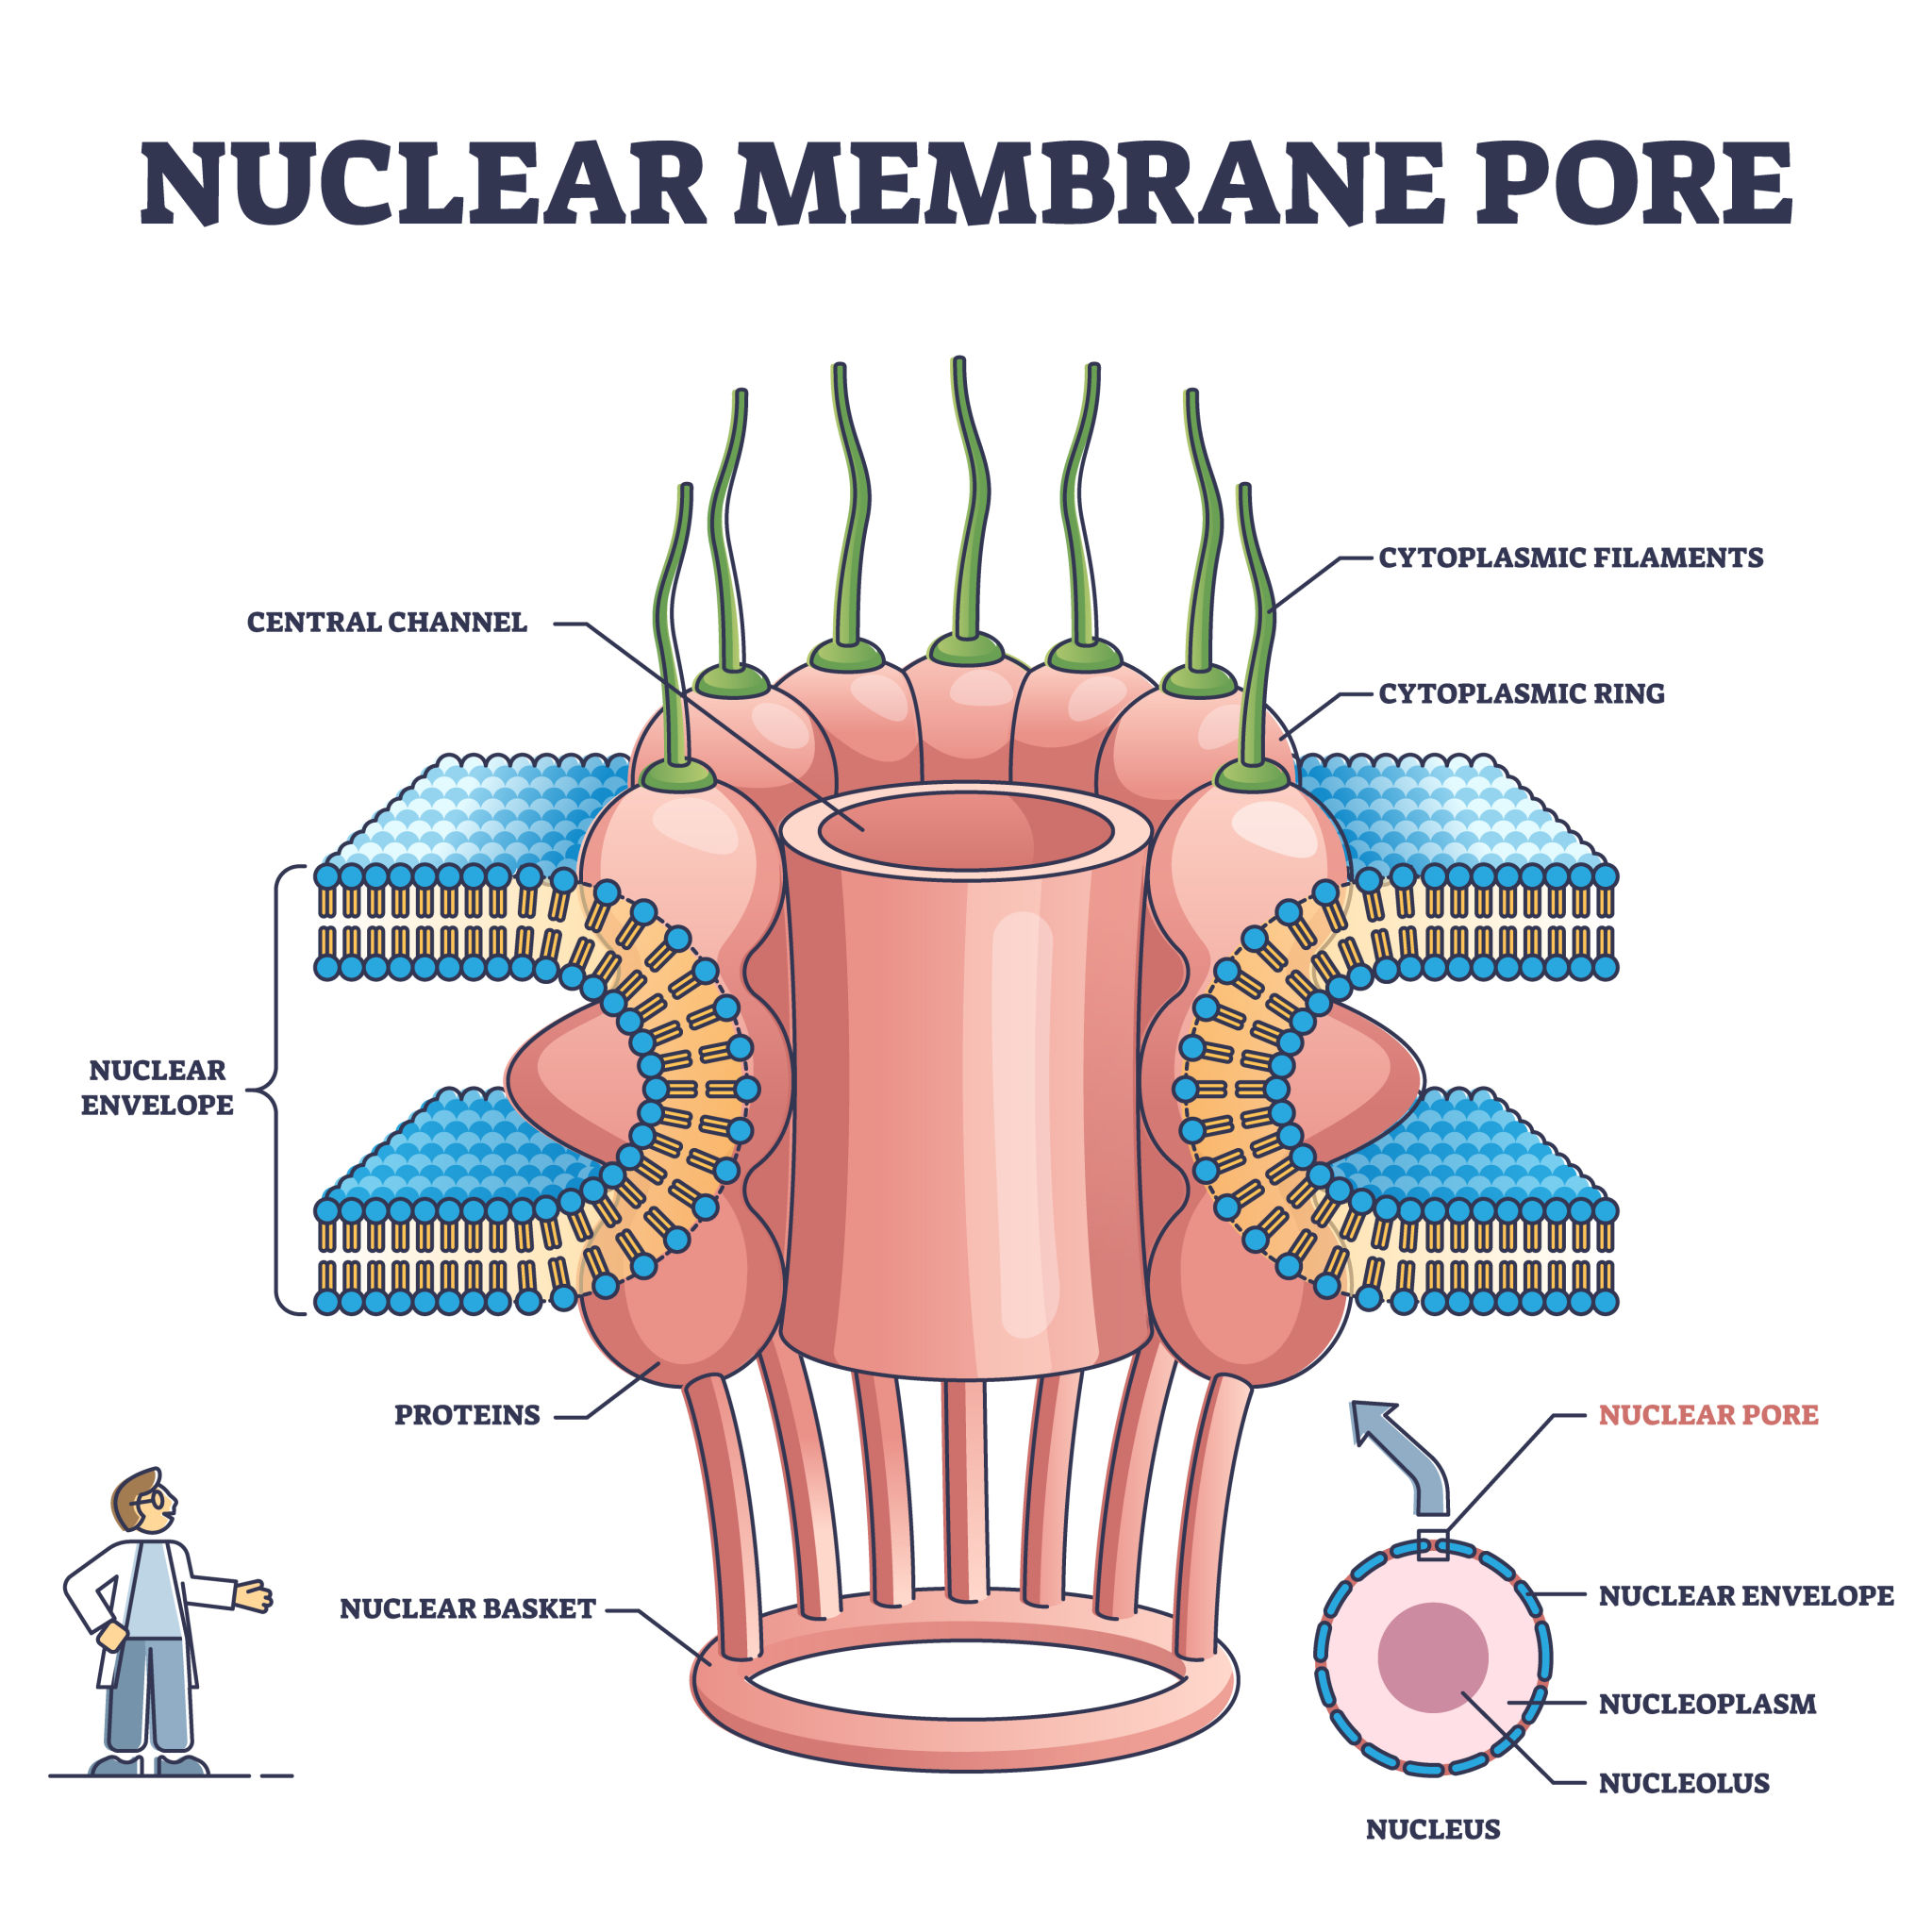

Slide 23
Structure
Double membrane nuclear envelope
Nuclear pores
Chromatin
Nucleolus
Functions
Genetic control of cell
DNA replication
RNA transcription
Cell division regulation
📌 Chromatin types:
Euchromatin → active
Heterochromatin → inactive

Slide 24
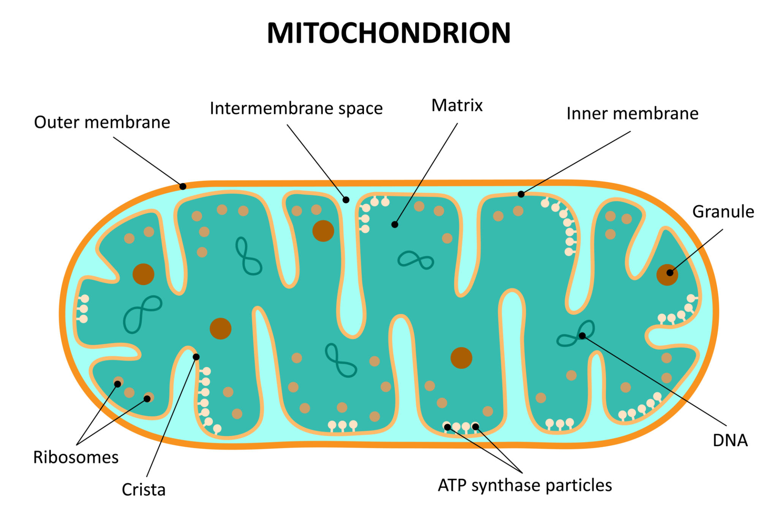
MITOCHONDRIA

Slide 25
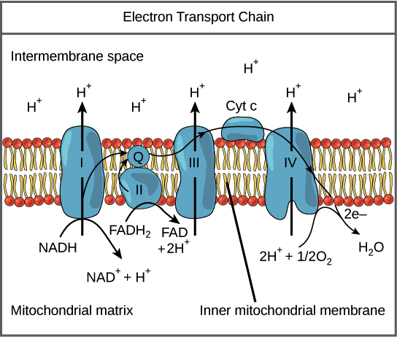

Slide 26
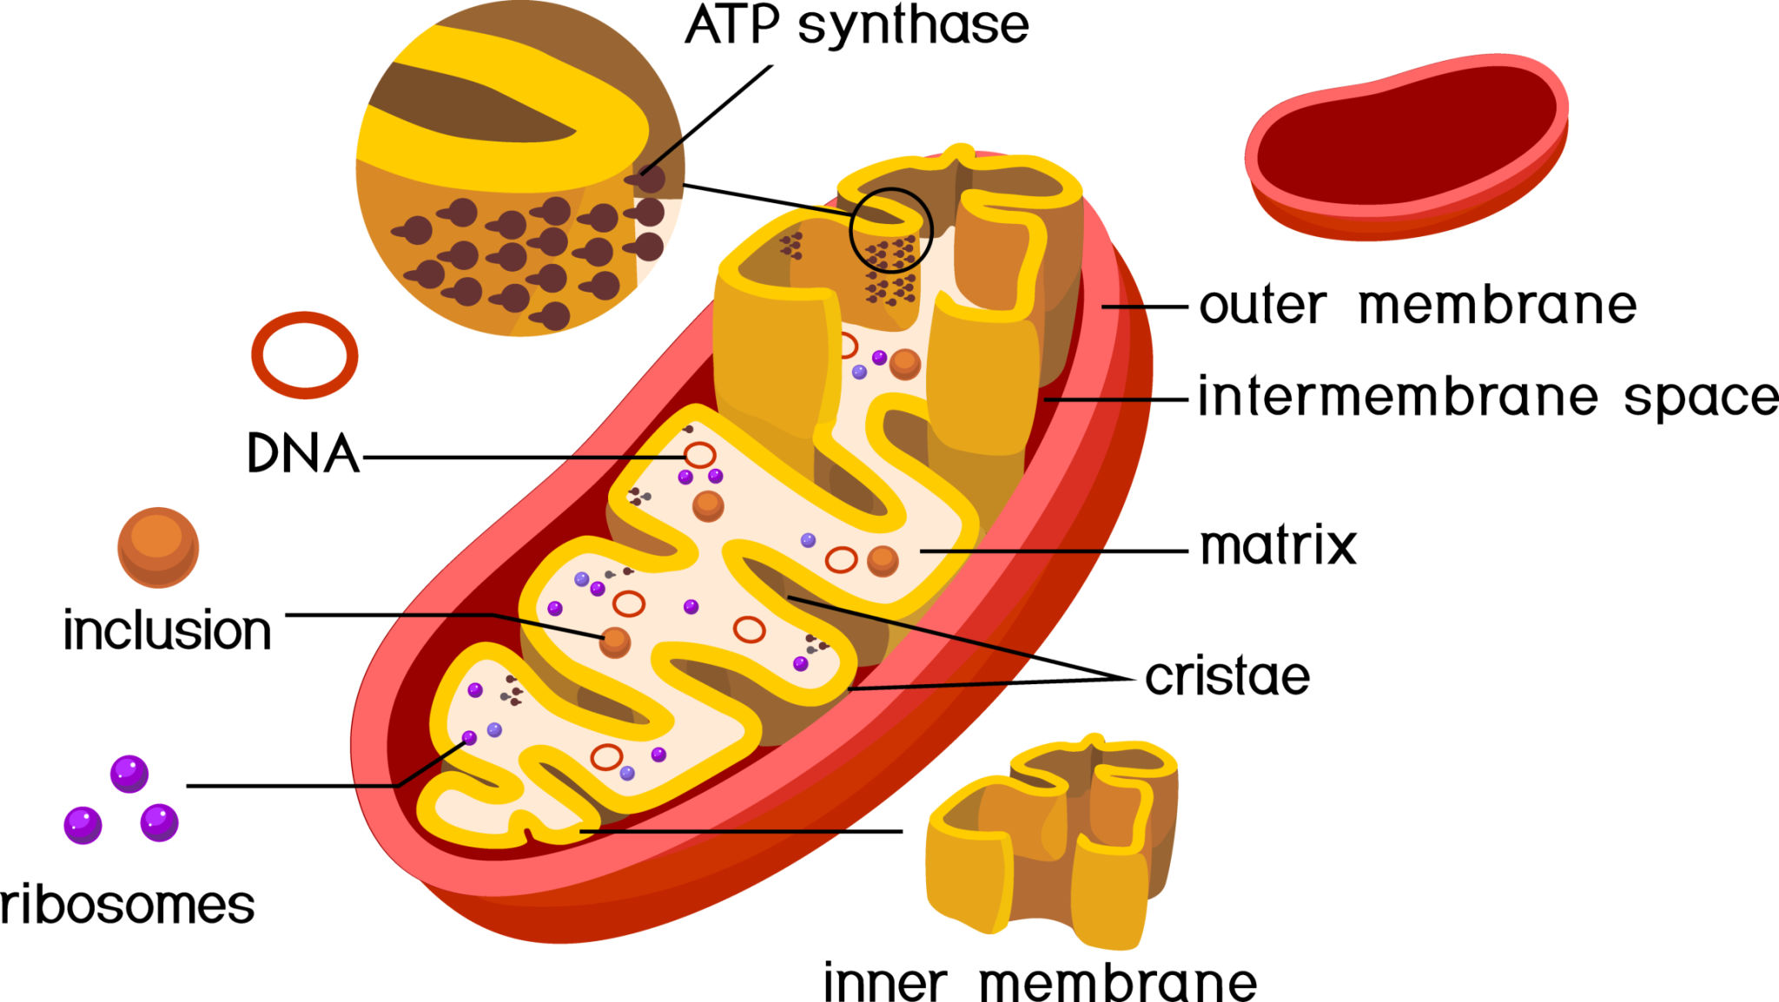

Slide 27
Structure
Outer membrane
Inner membrane → cristae
Matrix with enzymes & mtDNA
Functions
ATP production
Apoptosis regulation
Heat production
Calcium storage
📌 Exam pearl: Cells with high energy demand have more mitochondria

Slide 28
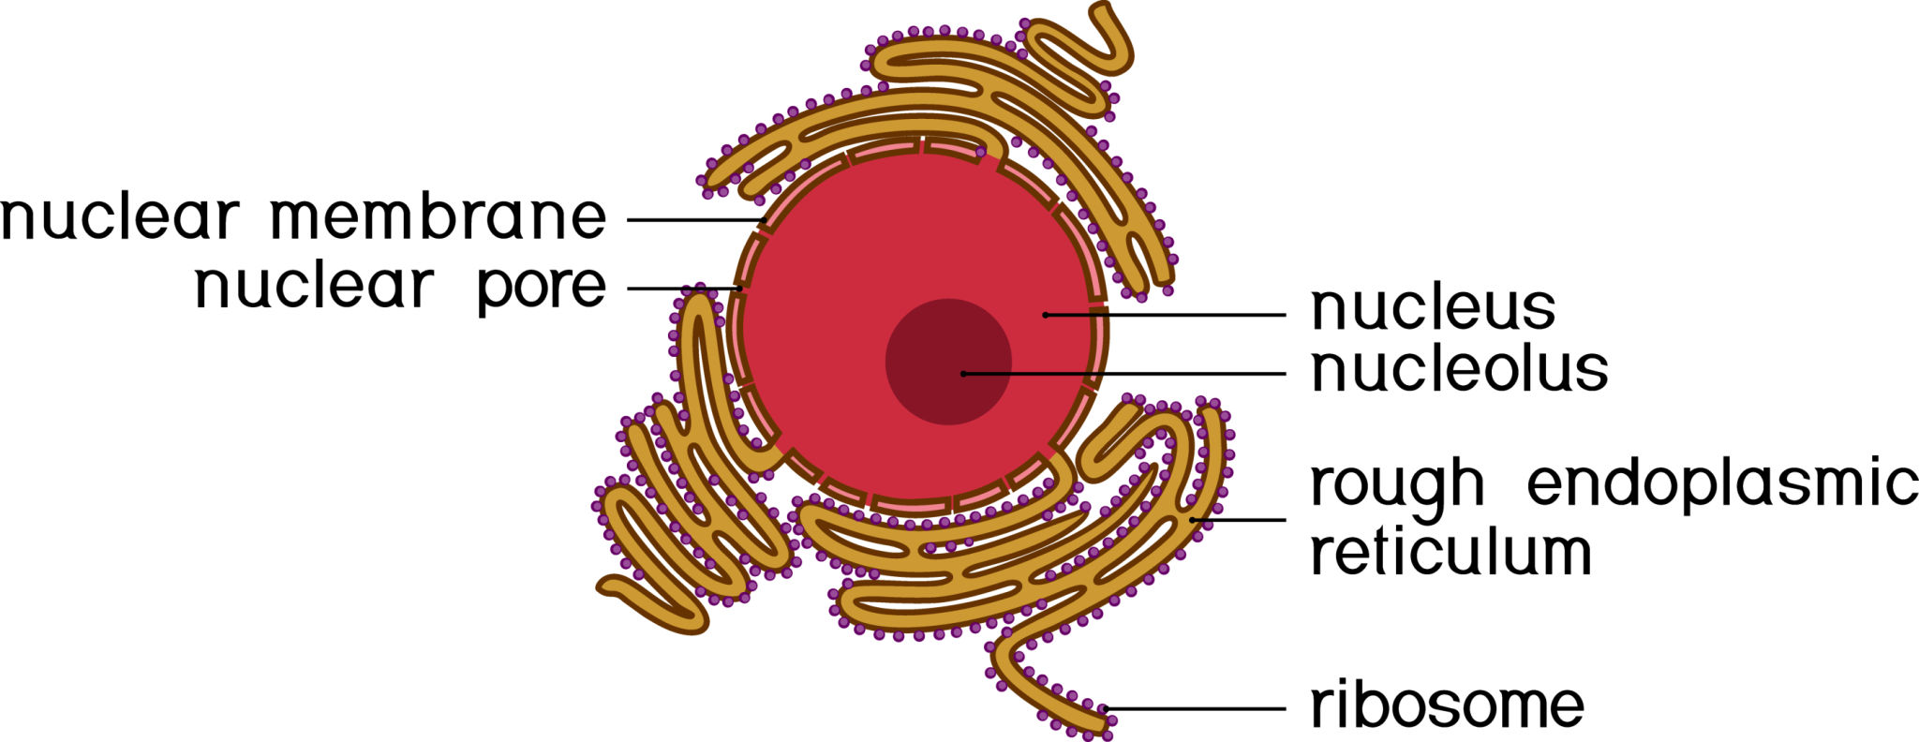
ENDOPLASMIC RETICULUM (ER)

Slide 29
Rough ER (RER)
Ribosome attached
Protein synthesis
Antibody formation
🔹 Smooth ER (SER)
Lipid & steroid synthesis
Detoxification (liver)
Calcium storage (muscle)
📌 Clinical: SER hypertrophy in chronic drug users

Slide 30
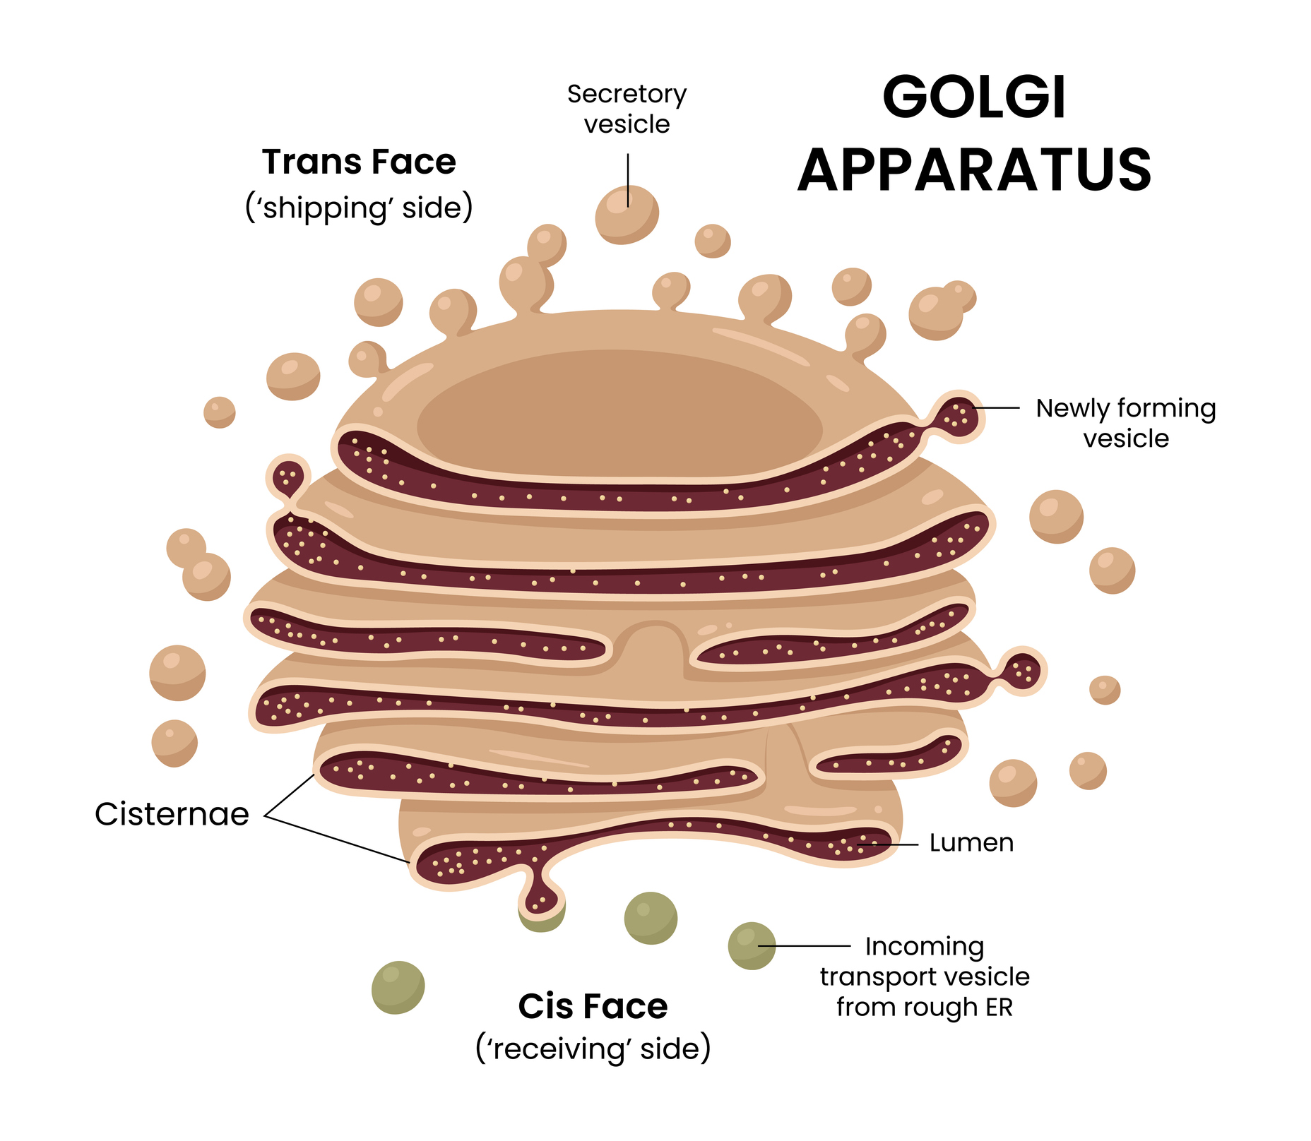
GOLGI APPARATUS

Slide 31
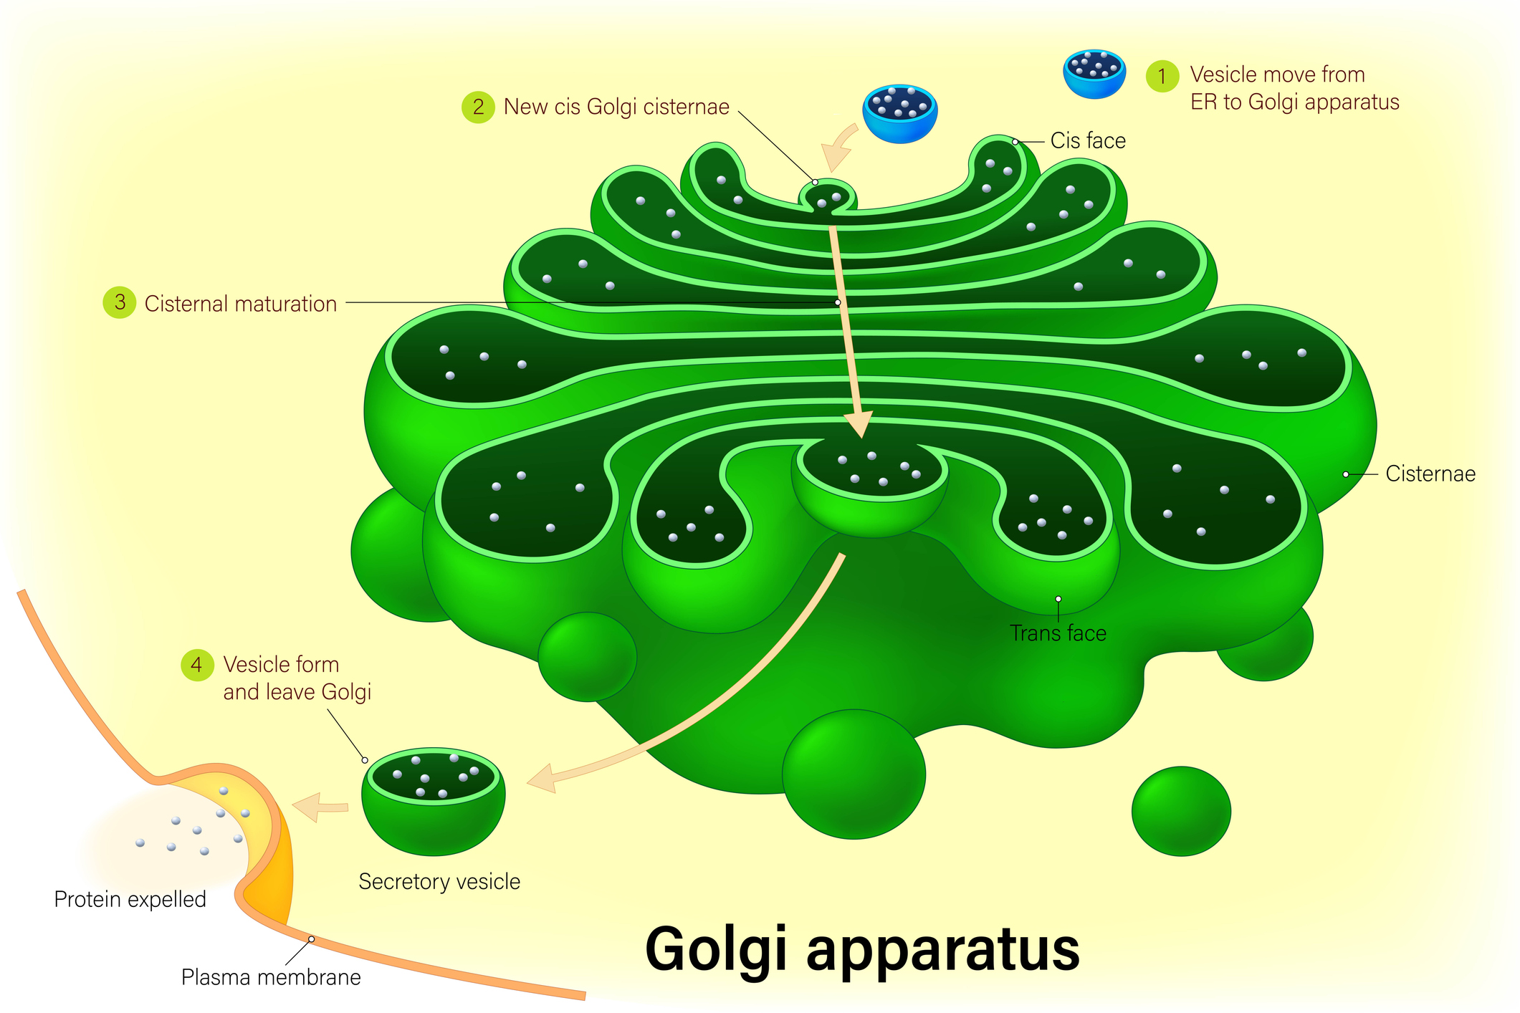

Slide 32
Functions
Protein modification (glycosylation)
Packaging & sorting
Lysosome formation
Secretion
📌 Faces:
Cis → receiving
Trans → shipping

Slide 33
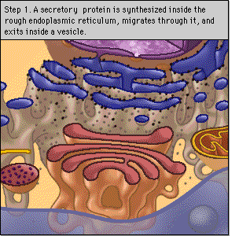

Slide 34
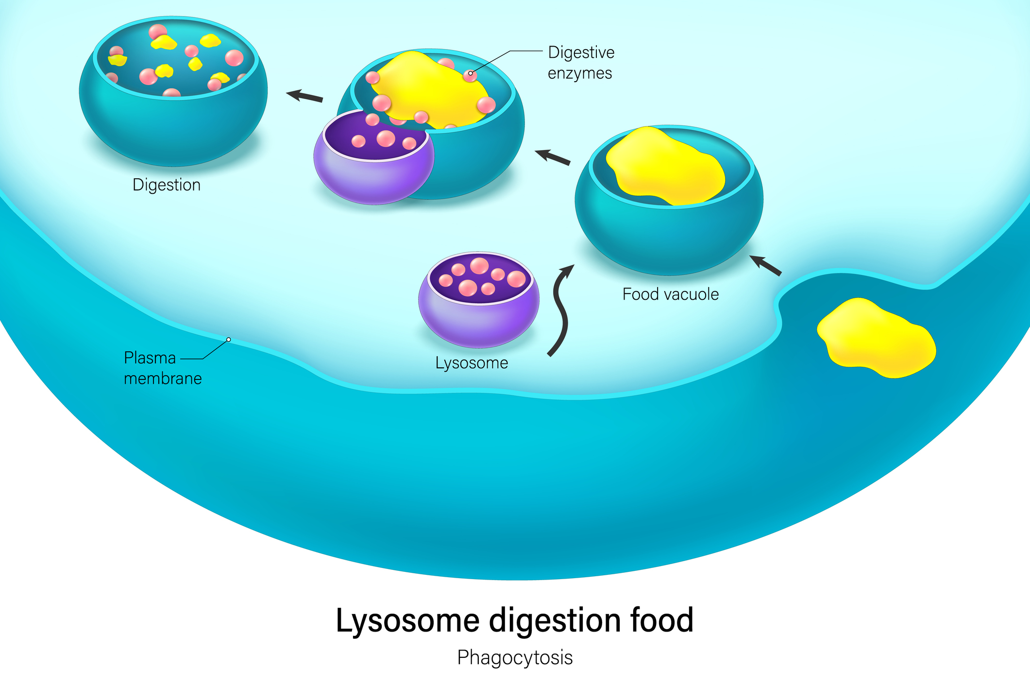
LYSOSOMES

Slide 35
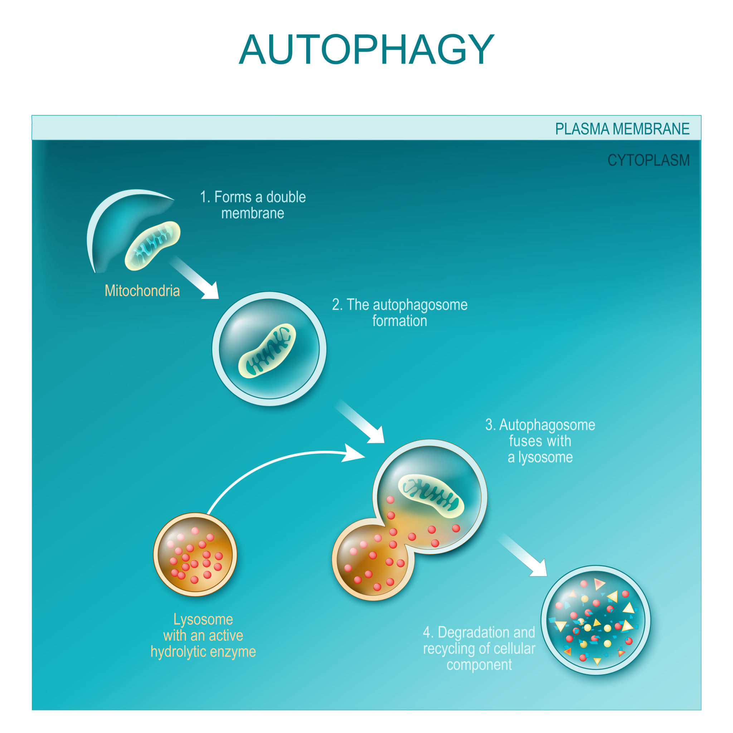

Slide 36
Functions
Intracellular digestion
Autophagy
Autolysis
📌 Exam line: “Lysosomes are suicide bags of the cell.”
📌 Clinical: Lysosomal storage diseases

Slide 37
PEROXISOMES
Functions
Detoxification
Breakdown of H₂O₂
Fatty acid oxidation
📌 Enzyme: Catalase

Slide 38
RIBOSOMES
Functions
Protein synthesis
📌 Types:
Free ribosomes → intracellular proteins
Bound ribosomes → secretory proteins

Slide 39
They consist of two subunits:
Larger 60s
Smaller 40s
It has 3 sites for mrna translation
E exit site
P peptidyl site
A aminoacyl site

Slide 40
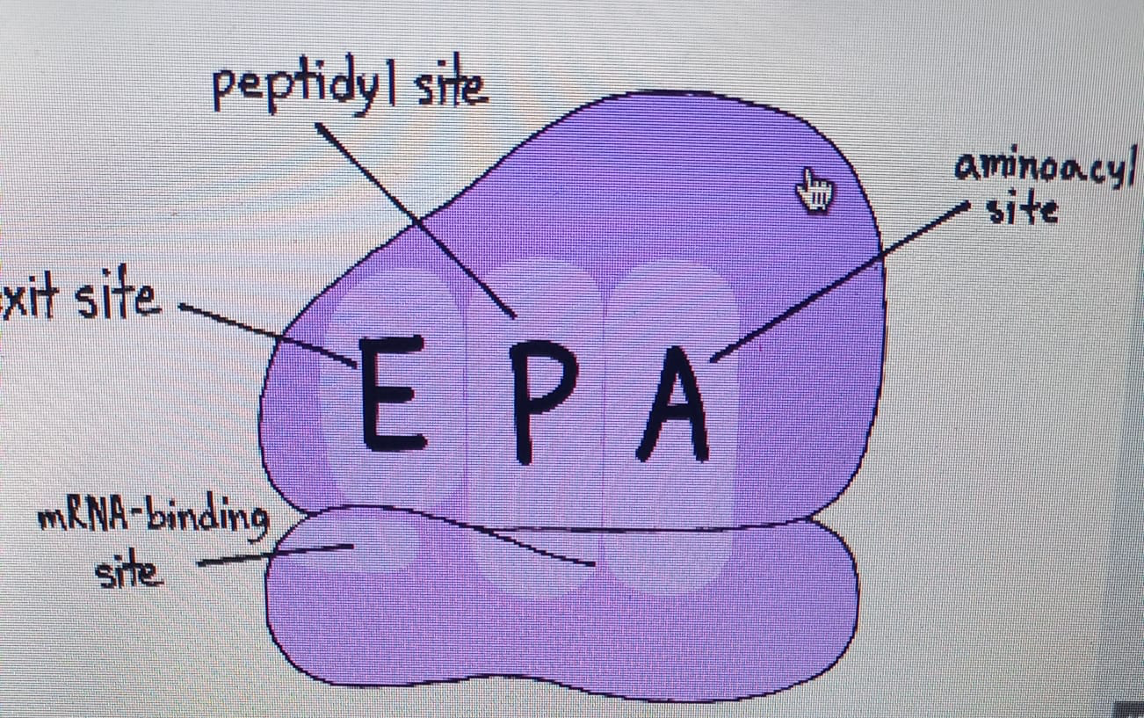

Slide 41
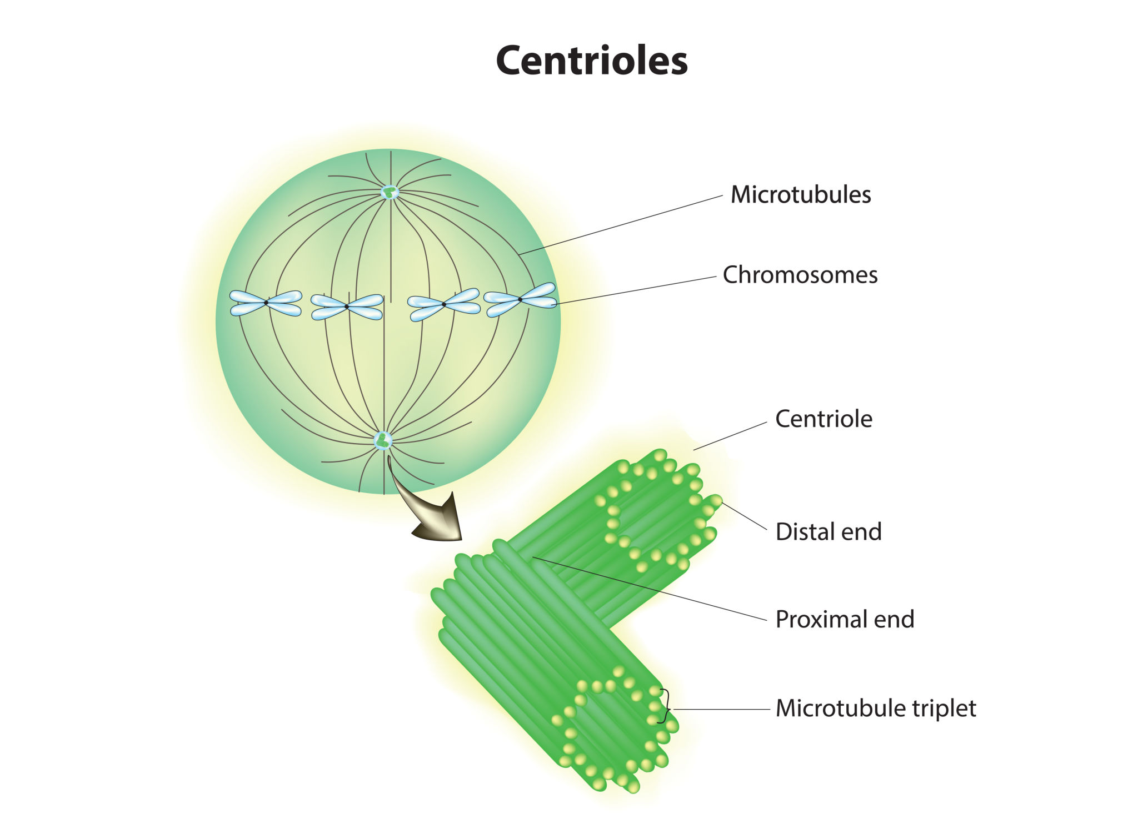
CENTROSOME & CENTRIOLES

Slide 42
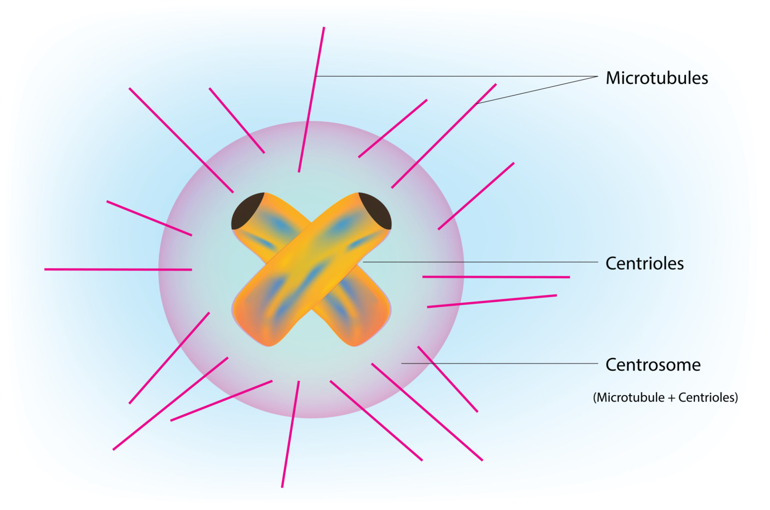

Slide 43
Functions
Spindle formation
Cell division

Slide 44
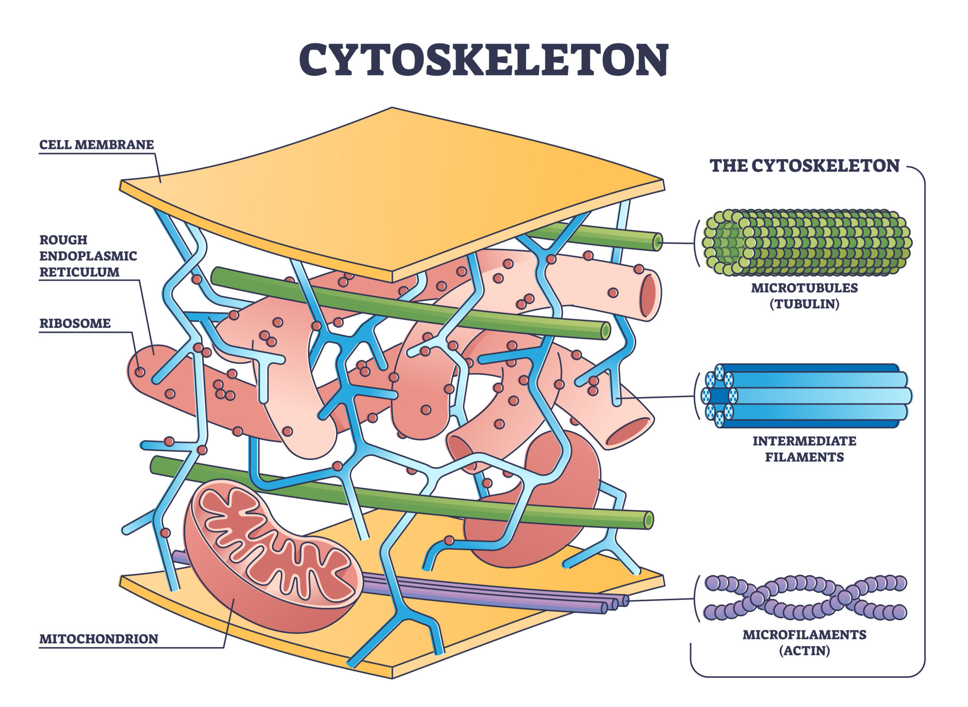

Slide 45
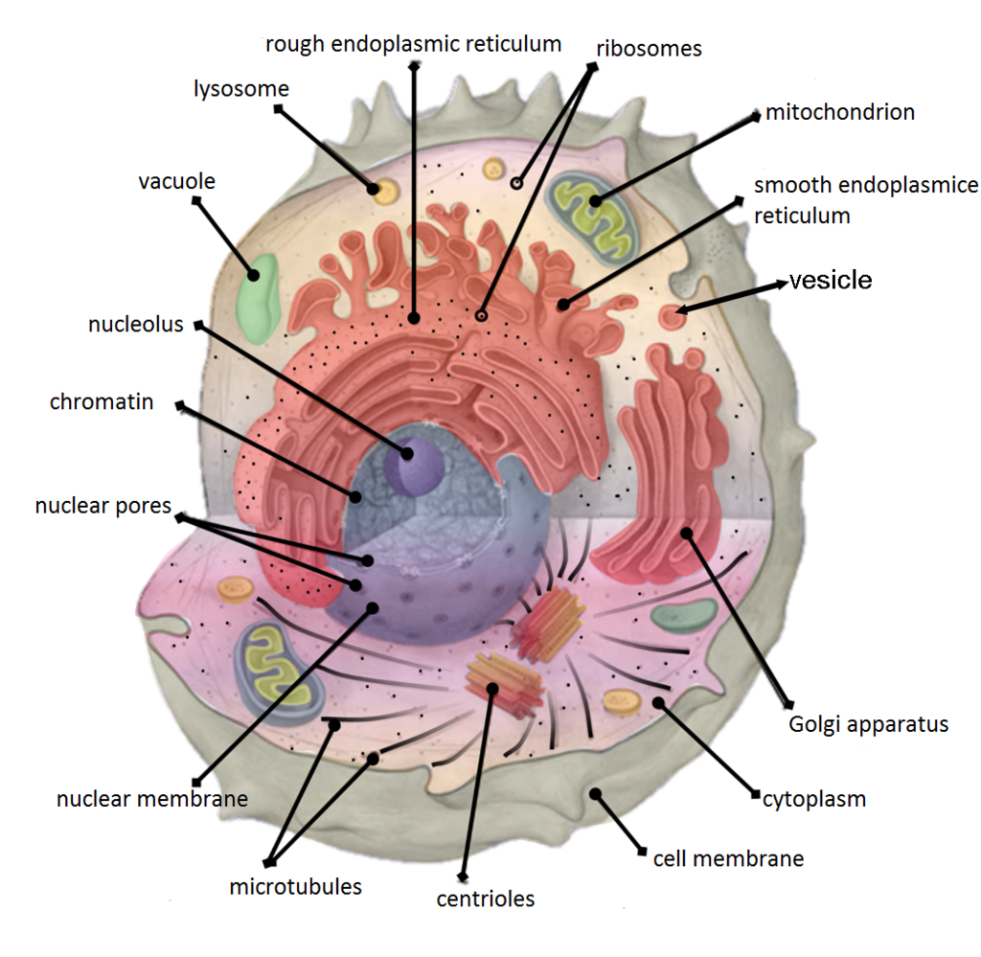

Slide 46
Cytoskeleton
A network of protein filaments present in the cytoplasm
Maintains cell shape, organization, and movement
Provides structural support to the cell
Main Functions
Maintains cell shape
Anchors organelles
Enables intracellular transport
Essential for cell division and motility
Major Components
Microfilaments
Intermediate filaments
Microtubules

Slide 47
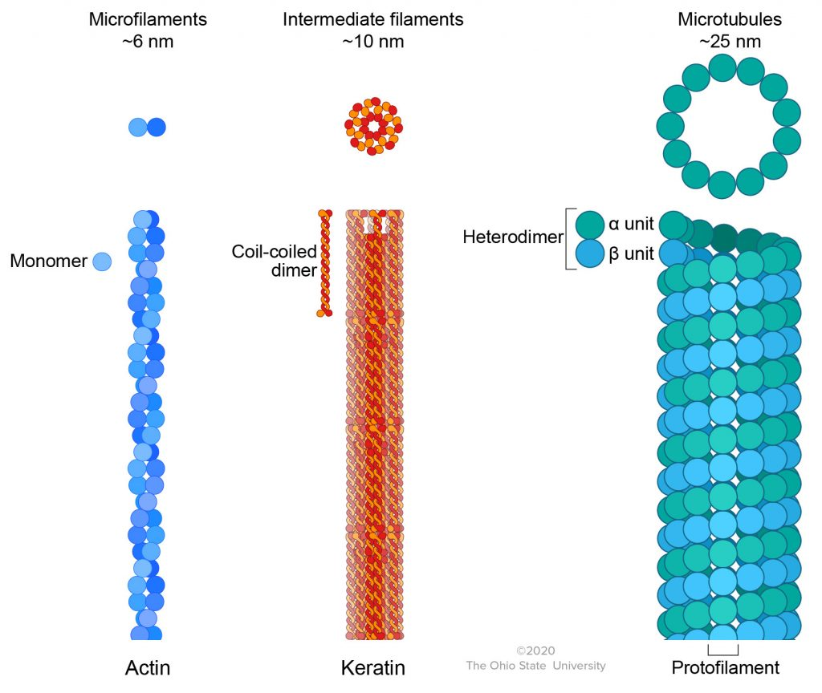

Slide 48
Microfilaments
Protein: Actin
Thinnest filaments
Located beneath cell membrane
Functions
Cell shape
Muscle contraction
Cell motility

Slide 49
Intermediate Filaments
Proteins: Keratin, vimentin, desmin
Strong & stable
Functions
Provide tensile strength
Resist mechanical stress
📌 Clinical: Defects → fragile cells

Slide 50
Microtubules
Protein: Tubulin
Largest filaments
Form spindle fibers, cilia, flagella
Functions
Chromosome movement
Vesicle transport
Cell division

Slide 51
Actin → movement
Keratin → strength
Tubulin → division & transport

Slide 52
SPECIALIZED CELL STRUCTURES
Microvilli
Increase surface area
Intestine
Cilia
Movement of mucus
Respiratory tract
Flagella
Sperm motility

Slide 53
Best Choice Questions (BCQs)
1. Powerhouse of cell? → Mitochondria
2. Organelle for protein modification? → Golgi apparatus
3. Calcium storage in muscle? → SER
4. Site of oxidative phosphorylation? → Inner mitochondrial membrane
5. Suicide bags of cell? → Lysosomes

